Slide 1
OPTIMIZE DEEP LEARNING FOR COVID-19 DETECTION FROM CHEST X-RAYS
Nov, 2025

Slide 2
AGENDA OVERVIEW
01
03
APPROACH
OPTIMIZATION TECHNIQUES
02
04
DATASET AND PREPROCESSING
METHODOLOGY

Slide 3
To solve this, optimization and search techniques like Hill Climbing, Tabu Search, Simulated Annealing, Particle Swarm, and Ant Colony were used to make model decisions optimal.
This project focuses on:
Implementing 2 AI models that classify COVID-19, Pneumonia, and Normal classes.
2. Optimize their predictions.
APPROACH

Slide 4
DATASET AND PREPROCESSING STAGE

Slide 5
PREPROCESSING STAGE
01
02
MERGE TWO DATASETS
EDA
We combined two datasets: Kaggle dataset of Normal class and a GitHub dataset of COVID-19 and pneumonia cases.
This merging aimed to create a balanced dataset, improve generalization, and ensure fairness in model training.
We explored the merged dataset to understand its structure, including the number of classes, image distribution, image types, and intensity values.
The analysis revealed an imbalanced class distribution, highlighting the need for resampling, which will be handled during preprocessing.

Slide 6
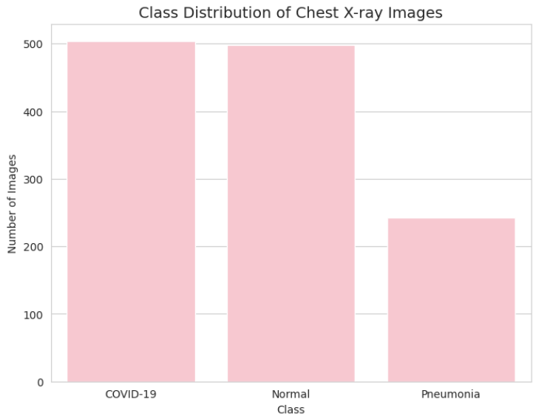
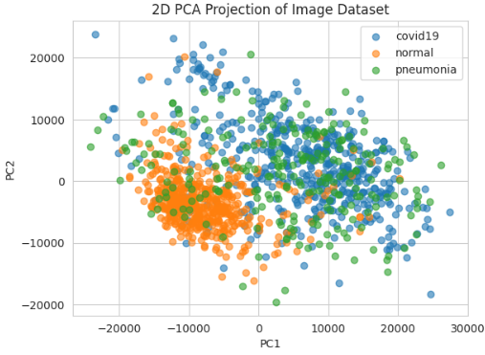
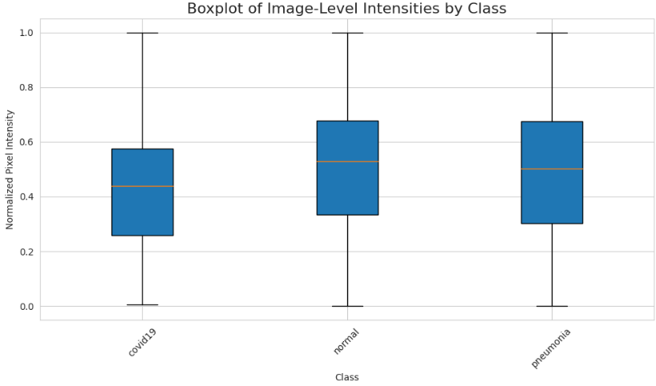

Slide 7
PREPROCESSING STAGE
03
In this step, we have applied several techniques to enhance image quality and balance the data, including:
Normalization
Standardization.
Gaussian Smoothing.
Histogram Equalization.
Gamma Correction.
Oversampling.
PREPROCESSING

Slide 8
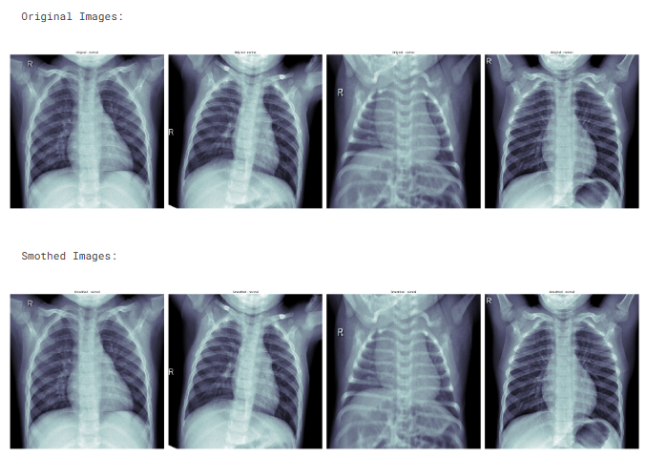

Slide 9
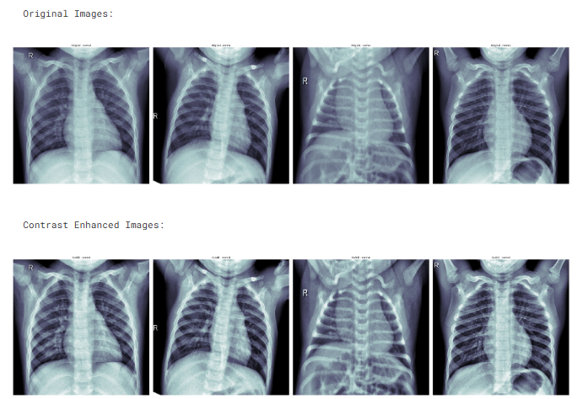

Slide 10
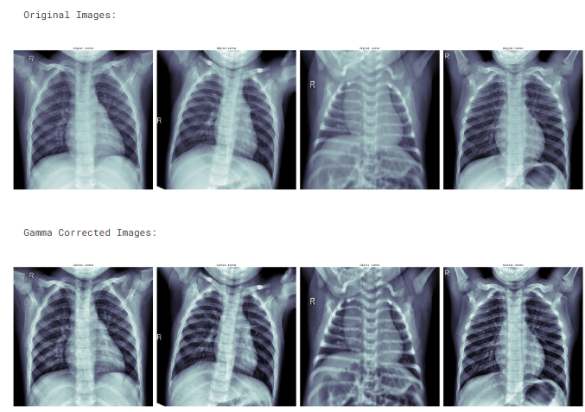

Slide 11
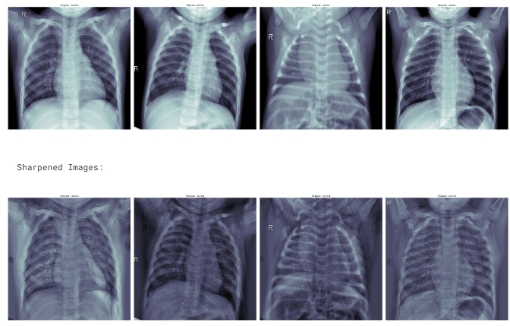
Excluded

Slide 12
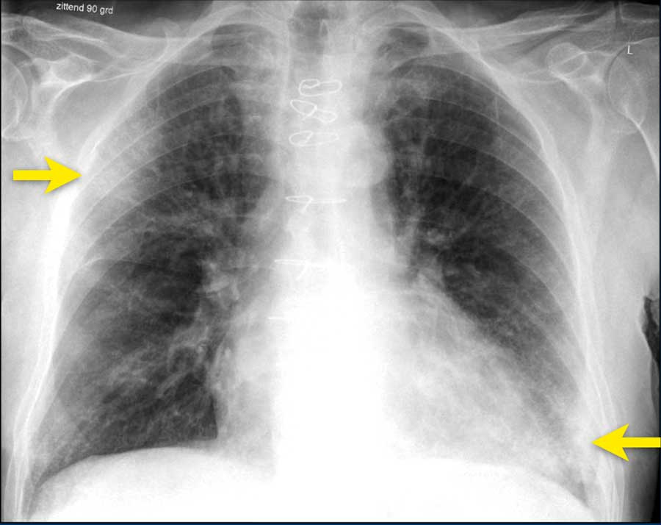
PREPROCESSING STAGE
04
FEATURE SELECTION
We have identified and removed X-ray images with annotations or arrows that could cause information leakage.
We have eliminated images that were too bright or too dark to prevent negative impacts on model training.

Slide 13
OPTIMIZATION STAGE I

Slide 14
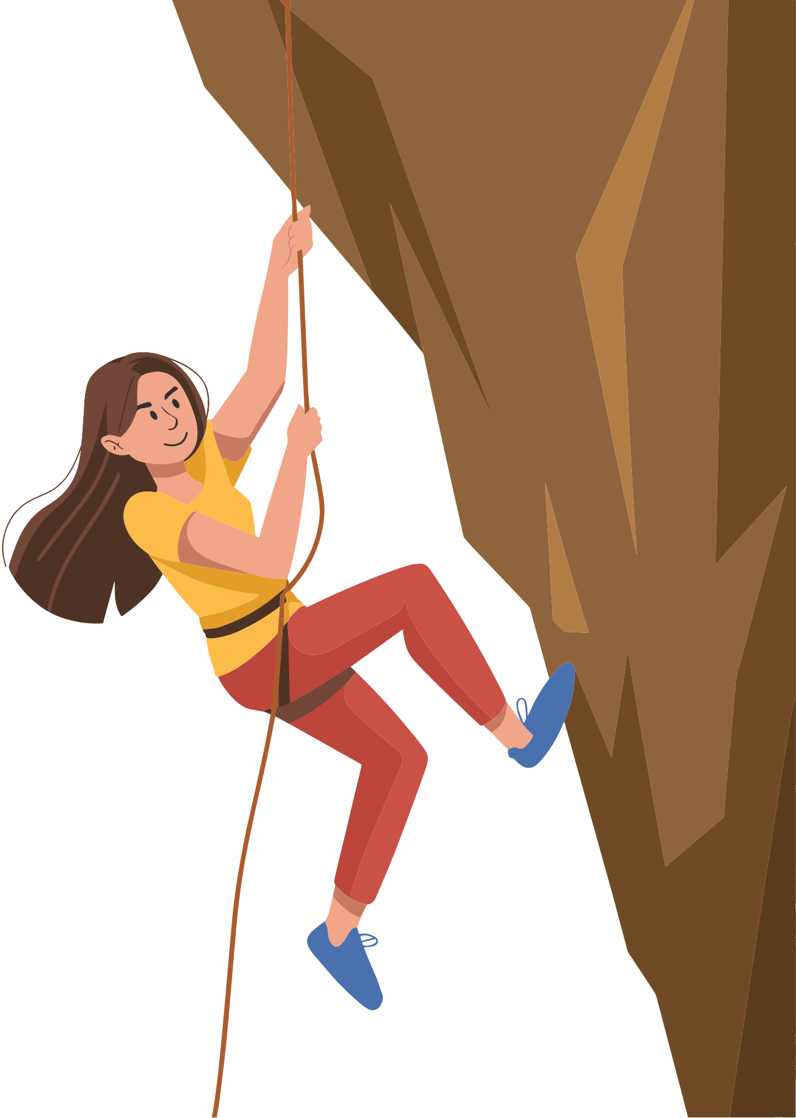



DCSNN
HILL CLIMBING
Hill Climb Configurations:
10 Epochs
3 Random Restarts
Old Results
New Results
At Epoch 10, the model reached:
Train accuracy: 0.9745
Val_accuracy: 0.8370
Configurations:
LR = 0.001
Batch = 16
Dropout = 0
Dense 1 = 32
Dense 2 = 16
At Epoch 10, the model reached:
Train accuracy: 0.9537
Val_accuracy: 0.8546
Configurations:
LR: 0.001
Batch: 8
Dropout: 0
Dense 1: 32
Dense 2: 16

Slide 15
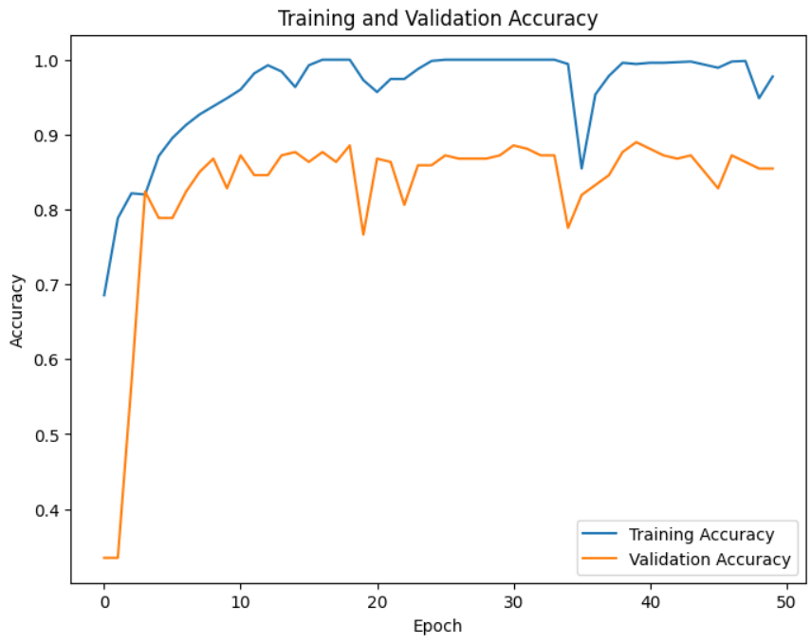

Slide 16


DCSNN
TABU SEARCH
TABU Configurations:
5 Iterations
Tenure Size = 2
10 Epochs
Old Results
New Results
At Epoch 10, the model reached:
Train accuracy: 0.9745
Val_accuracy: 0.8370
Configurations:
LR = 0.001
Batch = 16
Dropout = 0
Dense 1 = 32
Dense 2 = 16
At Epoch 10, the model reached:
Train accuracy: 0.9809
Val_accuracy: 0.9163
Configurations:
LR: 1e-05,
Batch: 8
Dropout: 0.2
Dense 1: 128
Dense 2: 48

Slide 17
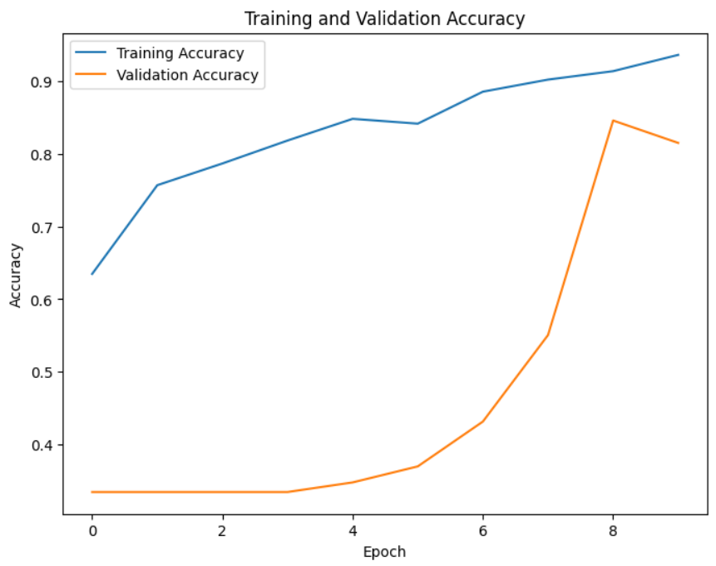

Slide 18
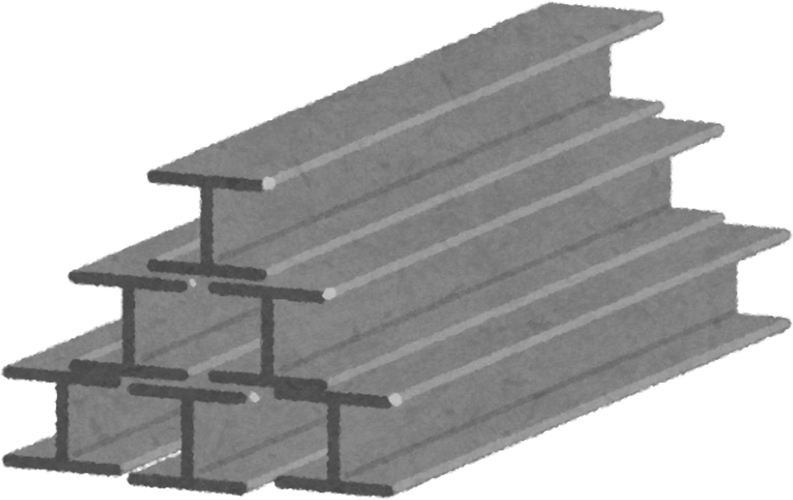

DCSNN
SIMULATED ANNEALING
Simulated Configurations:
10 Iterations
10 Epochs
Temperature = 1
alpha = 0.95
Old Results
New Results
At Epoch 10, the model reached:
Train accuracy: 0.9745
Val_accuracy: 0.8370
At Epoch 50, the model reached:
Train accuracy: 1.0000
Val accuracy: 0.8590
Configurations:
LR = 0.001
Batch = 16
Dropout = 0
Dense 1 = 32
Dense 2 = 16
At Epoch 10, the model reached:
Train accuracy: 0.9809
Val_accuracy: 0.8811
Configurations:
LR: 0.000501
Batch: 8
Dropout: 0
Dense 1: 48
Dense 2: 16

Slide 19
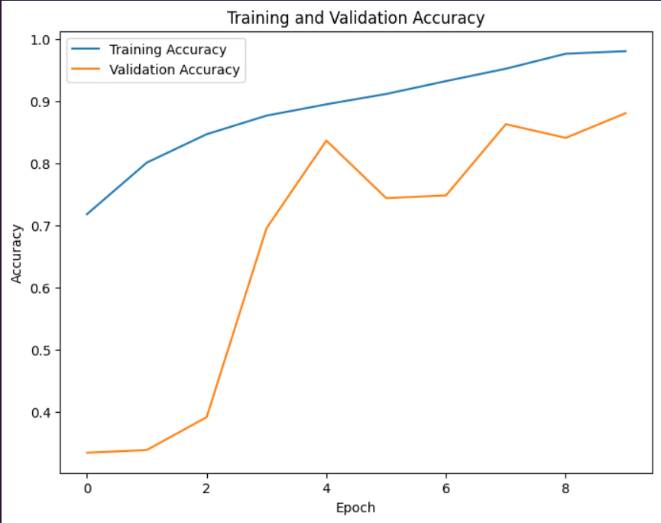

Slide 20
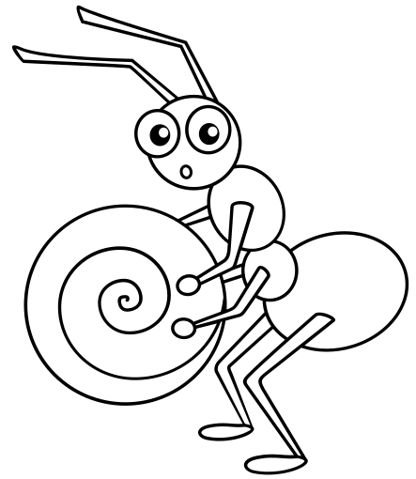

DCSNN
ANT COLONY
ACO Configurations:
10 Iterations
Ants= 10
10 Epochs
Old Results
New Results
At Epoch 10, the model reached:
Train accuracy: 0.9745
Val_accuracy: 0.8370
Configurations:
LR = 0.001
Batch = 16
Dropout = 0
Dense 1 = 32
Dense 2 = 16
12544 Features
At Epoch 10, the model reached:
Train accuracy: 0.8307
Val_accuracy: 0.8106
Configurations:
LR: 0.000501
Batch: 8
Dropout: 0
Dense 1: 48
Dense 2: 16
Reduced Features to : 6345

Slide 21
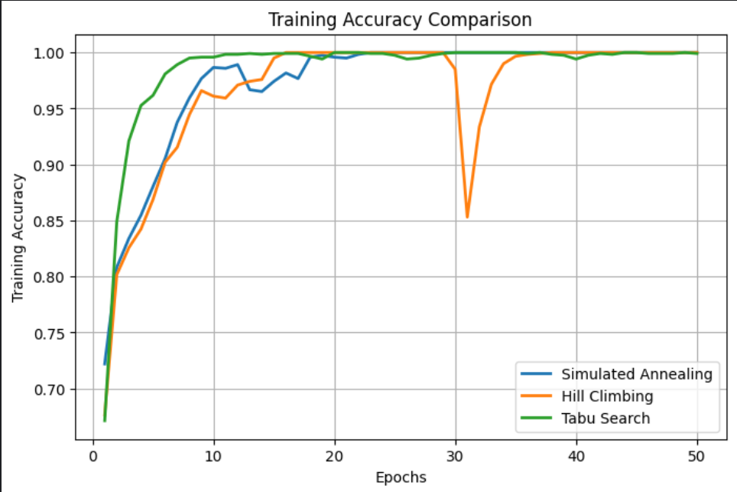
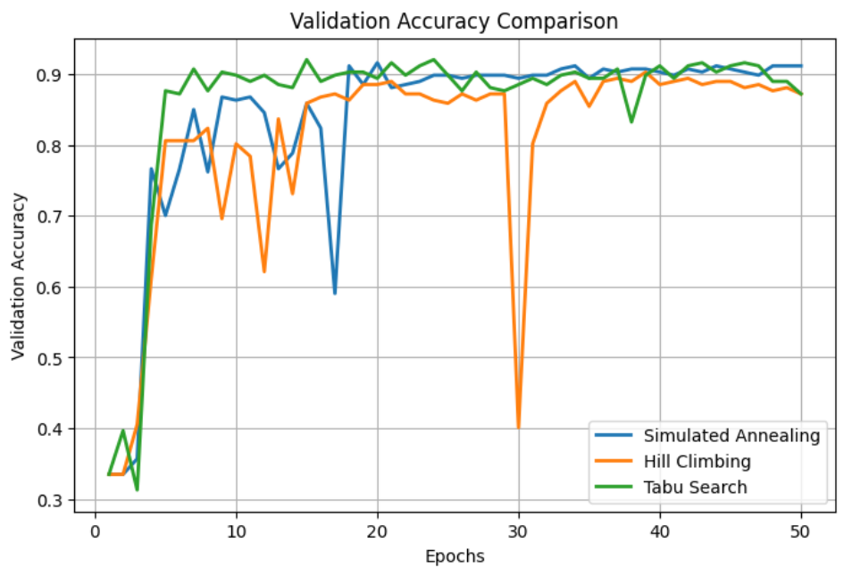
Simulated :
Train Accuracy: 1.0000
Validation Accuracy: 0.9119
Hill Climbing:
Train Accuracy: 1.0000
Validation Accuracy: 0.8722
TABU:
Train Accuracy: 0.9992
Validation Accuracy: 0.8722

Slide 22
SCOVNET
HILL CLIMBING
Hill Climb Configurations:
5 Epochs
25 Random Restarts
Old Results
New Results
At Epoch 5, the model reached:
Train accuracy: 0.6073
Val_accuracy: 0.6921
At Epoch 50, the model reached:
Train accuracy: 0.7809
Val accuracy: 0.7781
Configurations:
LR = 0.0001
Batch = 32
Dropout = 0
Dense 1 = 256
Dense 2 = 256
At Epoch 5, the model reached:
Train accuracy: 0.7147
Val_accuracy: 0.6933
Configurations:
LR: 0.000501
Batch: 16
Dropout: 0.1
Dense 1: 64
Dense 2: 64

Slide 23
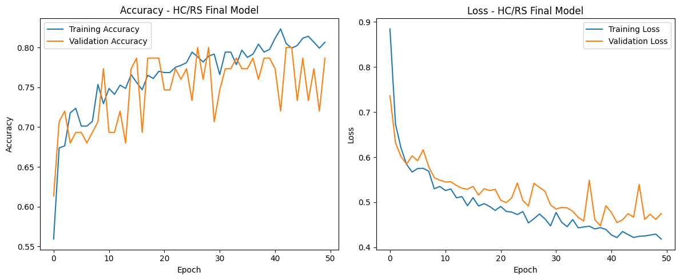

Slide 24
SCOVNET
TABU SEARCH
Tabu Search
5 Iterations
Tenure Size = 2
5 Epochs
Old Results
New Results
At Epoch 5, the model reached:
Train accuracy: 0.6073
Val_accuracy: 0.6921
At Epoch 50, the model reached:
Train accuracy: 0.7809
Val accuracy: 0.7781
Configurations:
LR = 0.0001
Batch = 32
Dropout = 0
Dense 1 = 256
Dense 2 = 256
At Epoch 5, the model reached:
Train accuracy: 0.6643
Val_accuracy: 0.6667
Configurations:
LR: 0.000610
Batch: 8
Dropout: 0.5
Dense 1: 144
Dense 2: 144

Slide 25
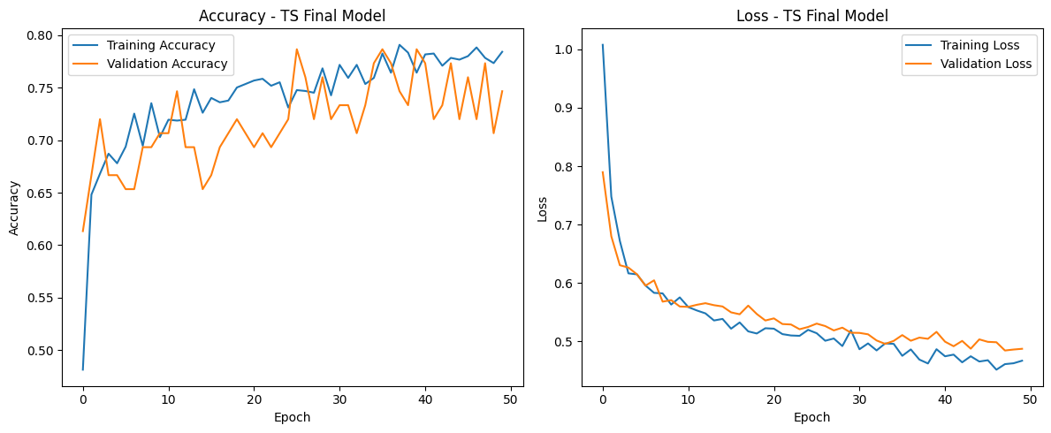

Slide 26
SCOVNET
SIMULATED ANNEALING
Simulated Configurations:
25 Iterations
5 Epochs
Temperature = 1
alpha = 0.95
Old Results
New Results
At Epoch 10, the model reached:
Train accuracy: 0.6073
Val_accuracy: 0.6921
At Epoch 50, the model reached:
Train accuracy: 1.0000
Val accuracy: 0.8590
Configurations:
LR = 0.001
Batch = 16
Dropout = 0
Dense 1 = 32
Dense 2 = 16
At Epoch 5, the model reached:
Train accuracy: 0.7175
Val_accuracy: 0.8502
Configurations:
LR: 0.00063
Batch: 8
Dropout: 0.2
Dense 1: 64
Dense 2: 64

Slide 27
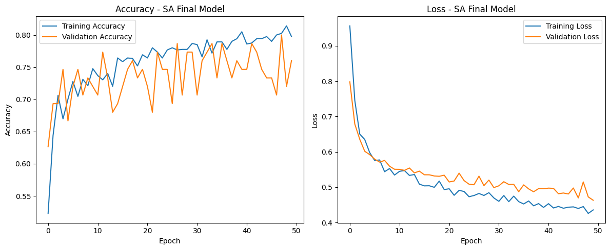

Slide 28

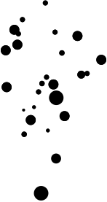
SCOVNET
PARTICLE SWARM
Particle Swarm Configurations:
10 Iterations
5 Epochs
15 particles
Old Results
New Results
At Epoch 5, the model reached:
Train accuracy: 0.6073
Val_accuracy: 0.6921
At Epoch 50, the model reached:
Train accuracy: 0.7809
Val accuracy: 0.7781
Configurations:
LR = 0.0001
Batch = 32
Dropout = 0
Dense 1 = 256
Dense 2 = 256
At Epoch 5, the model reached:
Train accuracy: 0.7294
Val_accuracy: 0.7333
Configurations:
LR: 0.000458
Batch: 8
Dropout: 0.1292
Dense 1: 185
Dense 2: 185

Slide 29
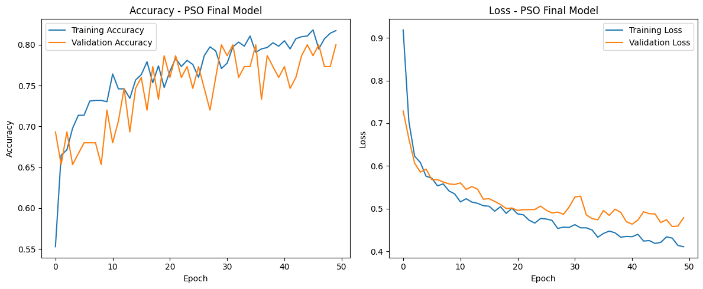

Slide 30
SCOVNET
ANT COLONY
ACO Configurations:
15 Iterations
Ants= 15
5 Epochs
Old Results
New Results
At Epoch 5, the model reached:
Train accuracy: 0.6073
Val_accuracy: 0.6921
At Epoch 50, the model reached:
Train accuracy: 0.7809
Val accuracy: 0.7781
Configurations:
LR = 0.0001
Batch = 32
Dropout = 0
Dense 1 = 256
Dense 2 = 256
At Epoch 5, the model reached:
Train accuracy: 0.7294
Val_accuracy: 0.7333
Configurations:
LR: 0.000458
Batch: 8
Dropout: 0.1292
Dense 1: 185
Dense 2: 185

Slide 31
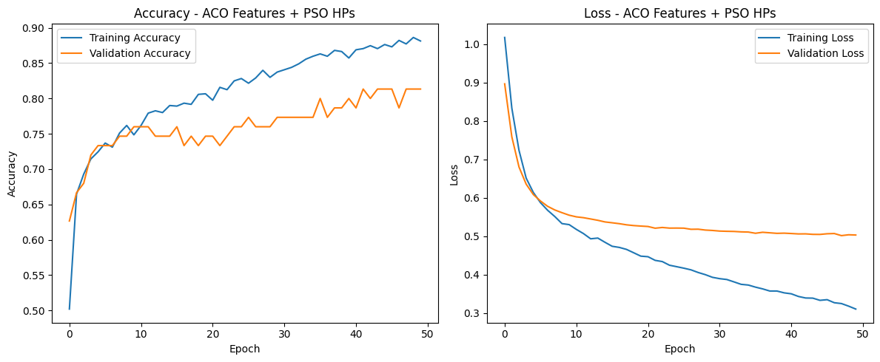

Slide 32
OPTIMIZATION STAGE II

Slide 33
SCOVNET-HILL CLIMB + PARTICLE SWARM
Hill Climb Configurations:
5 Epochs
5 Random Restarts
Old Results
New Results
At Epoch 5, the model reached:
Train accuracy: 0.6073
Val_accuracy: 0.6921
At Epoch 50, the model reached:
Train accuracy: 0.7809
Val accuracy: 0.7781
Configurations:
LR = 0.0001
Batch = 32
Dropout = 0
Dense 1 = 256
Dense 2 = 256
At Epoch 5, the model reached:
Train accuracy: 0.9400
Val_accuracy: 0.9200
At Epoch 50, the model reached:
Train accuracy: 0.7867
Val accuracy:0.7780
Configurations:
LR = 0.0001
Batch = 32
Dropout = 0
Dense 1 = 256
Dense 2 = 256
w = 0.4000000000000001
c = 0.75
c2 = 2.25

Slide 34
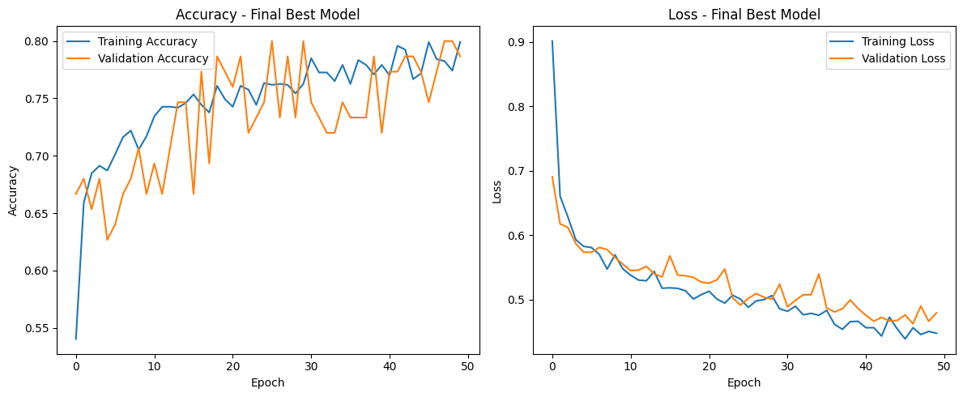

Slide 35
SCOVNET-HILL CLIMB + SIMULATED ANNEALING
Hill Climb Configurations:
5 Epochs
5 Random Restarts
Old Results
New Results
At Epoch 5, the model reached:
Train accuracy: 0.6073
Val_accuracy: 0.6921
At Epoch 50, the model reached:
Train accuracy: 0.7809
Val accuracy: 0.7781
Configurations:
LR = 0.0001
Batch = 32
Dropout = 0
Dense 1 = 256
Dense 2 = 256
At Epoch 5, the model reached:
Train accuracy: 0.6042
Val_accuracy: 0.6933
At Epoch 50, the model reached:
Train accuracy: 0.7214
Val accuracy: 0.7333
Configurations:
LR: 0.000100
Batch: 16
Dropout: 0.3000
Dense 1: 144
Dense 2: 144
alpha: 1.0537005644903412e-07
T0: 5
iters: 25

Slide 36
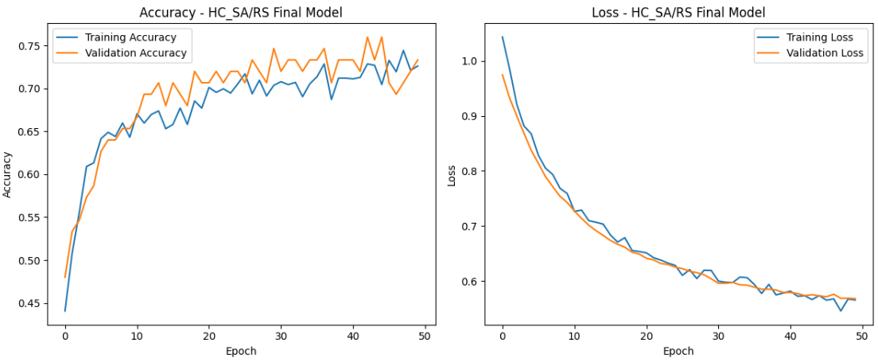

Slide 37
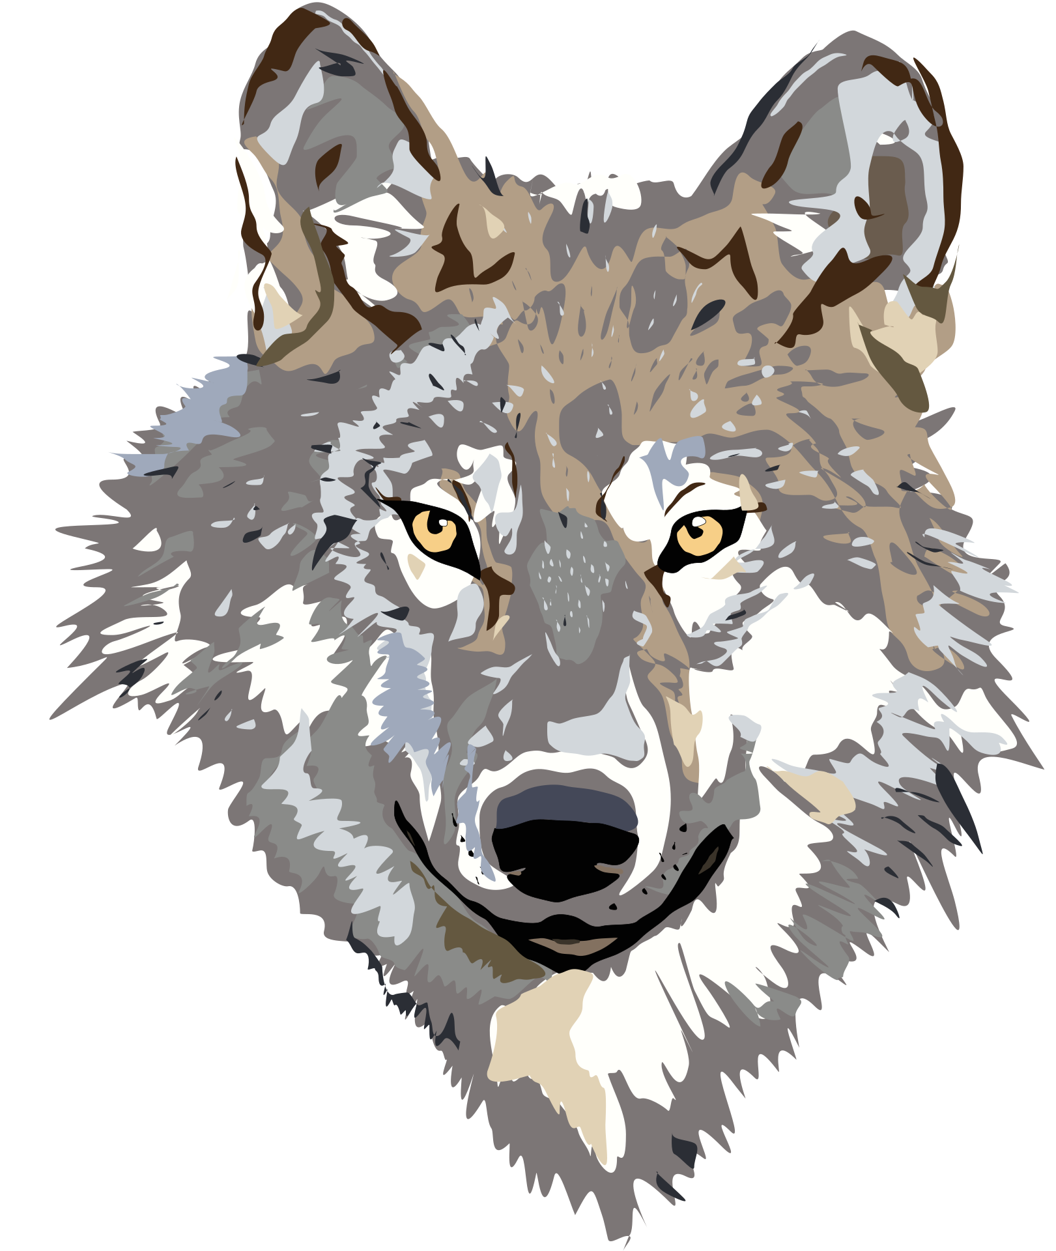
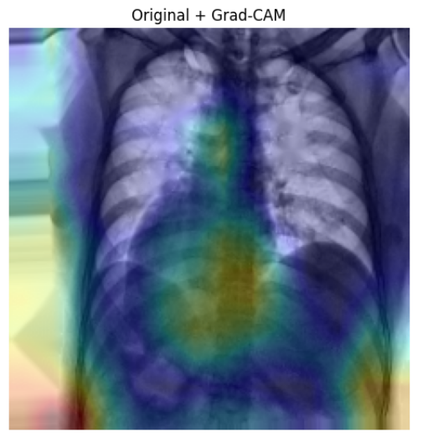
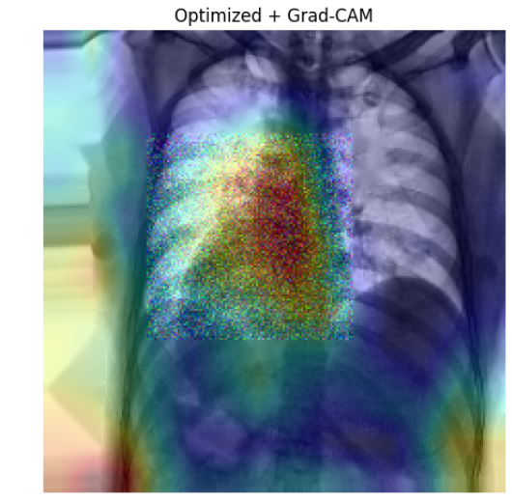
SCOVNET GRAY WOLF + GRAD-CAM
Gray Wolf Configurations:
50 Epochs
10 Wolf
Old Results
New Results

Slide 38
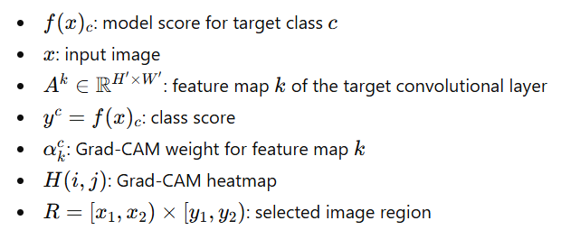
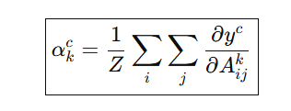
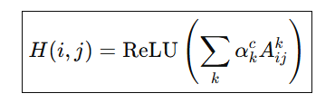
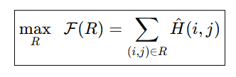
GRAD-CAM
Objective:

Slide 39
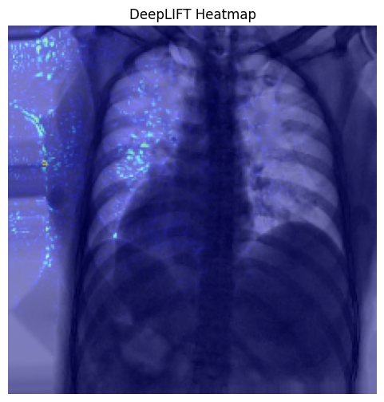
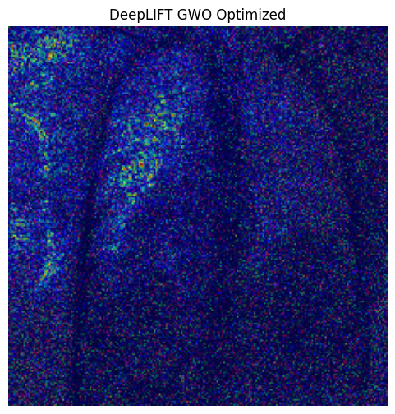
SCOVNET GRAY WOLF + DEEPLIFT
Gray Wolf Configurations:
50 Epochs
10 Wolf
Old Results
New Results

Slide 40
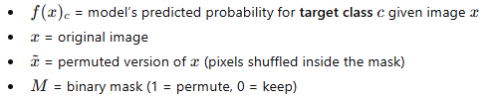
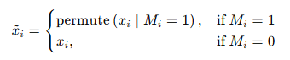
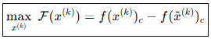
DEEPLIFT
Objective:

Slide 41
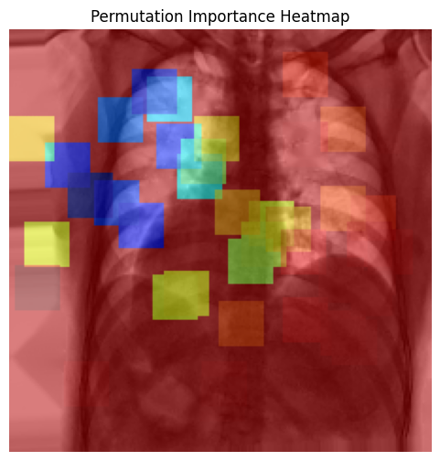
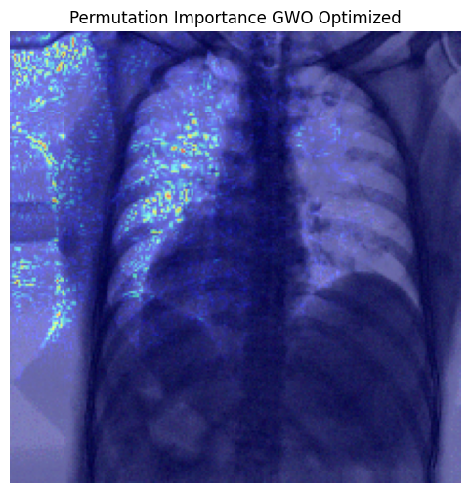
SCOVNET GRAY WOLF + PERMUATION IMPORTANCE
Gray Wolf Configurations:
50 Epochs
10 Wolf
Old Results
New Results

Slide 42
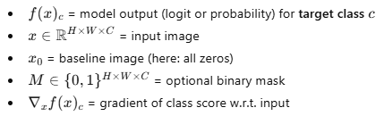
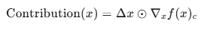
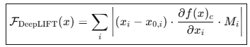
PERMUATION IMPORTANCE
Objective:

Slide 43
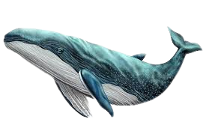
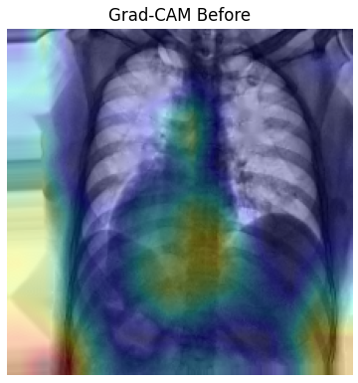
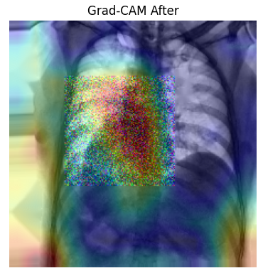
SCOVNET WHALE OPTIMIZATION + GRAD-CAM
Whale Configurations:
50 Epochs
10 Whales
Old Results
New Results

Slide 44

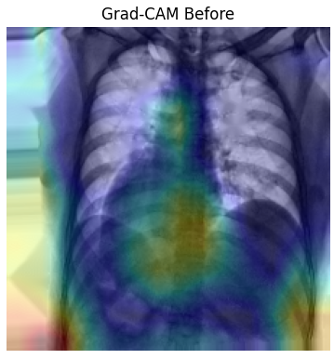
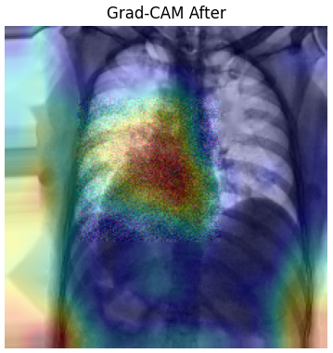
FIRE FLY OPTIMIZATION + GRAD-CAM
FireFly Configurations:
50 Epochs
10 Fireflies
Old Results
New Results

Slide 45
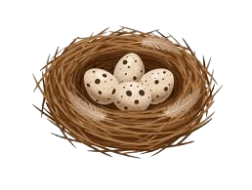
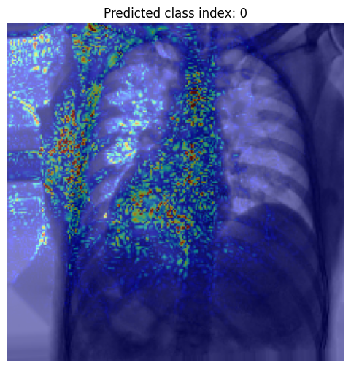
CUCKOO SEARCH OPTIMIZATION + DEEPLIFT
Gray Wolf Configurations:
30 Epochs
10 Cuckoo
Old Results
New Results

Slide 46
Meta-optimization (HC → PSO) significantly improved convergence and accuracy.
Simulated Annealing remained the strongest single optimizer for generalization.
Swarm-based methods were more effective for both:
Model optimization
XAI map refinement
Grad-CAM + PSO provided the best trade-off between:
Performance
Interpretability
Clinical trust
INTEGRATED FINDINGS

Slide 47
Using one metaheuristic to optimize another enhances learning stability and robustness.
Optimized configurations should be reused for XAI enhancement.
Combining accuracy + explainability + optimization produces a reliable medical AI system.
The proposed framework is scalable, interpretable, and suitable for real clinical deployment.
CONCLUSION

Slide 48
ANY QUESTIONS?

Slide 49

THANK YOU
CONTACT US:
s-doha.hassanien@zewailcity.edu.eg
s-salma.ali@zewailcity.edu.eg

